Slide 1

RC Car Controlled via Android Smartphone App
Professor James Tandon
Senior Design Il
The Engineers
Josh Prudente
Mirza Ahmetspahic
Okechukwu Ezeife

Slide 2

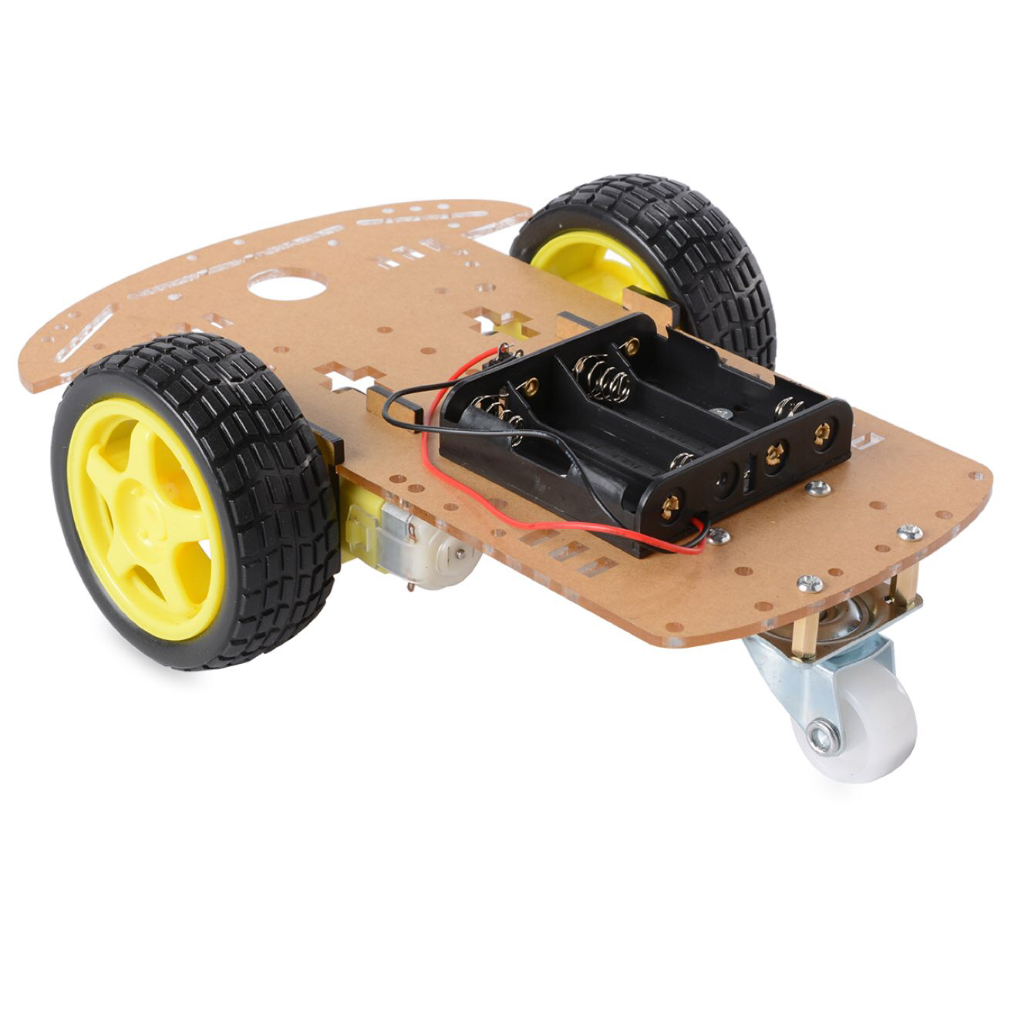
Introduction
We are making an RC Car operated through the use of an Android Smartphone
This smartphone will have 3 different modes:
Control Mode
Self-Driving Mode
Hybrid Mode
CPU: Atmega328P
Prominent Subsystems:
L293D Motor Driver
Bluetooth Module
Ultrasonic Distance Sensor
Pocket AVR Programmer
Android Smartphone

Slide 3
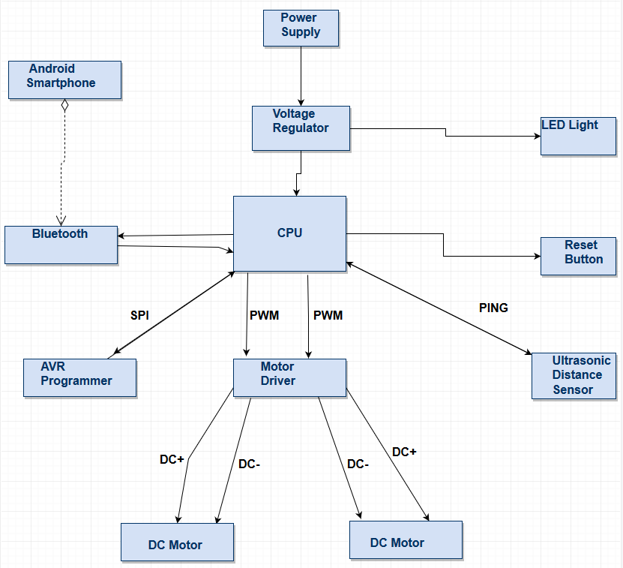

Slide 4
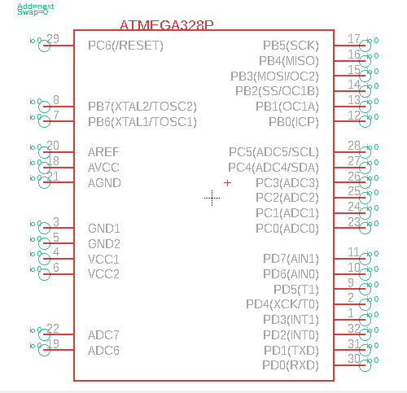
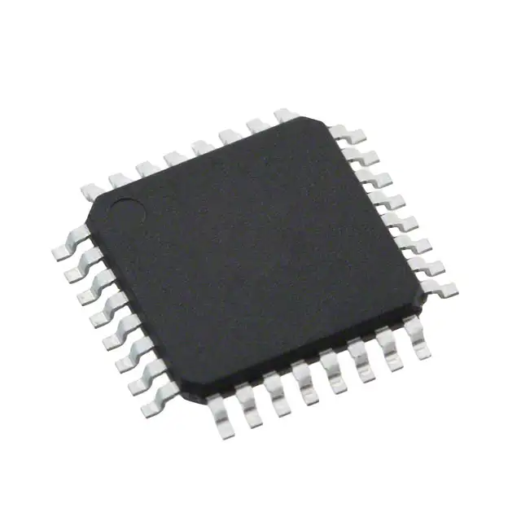
The CPU
The Atmega328P
32 Pins
6 PWM Channels
32kB Memory
Chosen for its ability to act as an Arduino “clone”
Burned an Arduino Bootloader using Arduino IDE

Slide 5
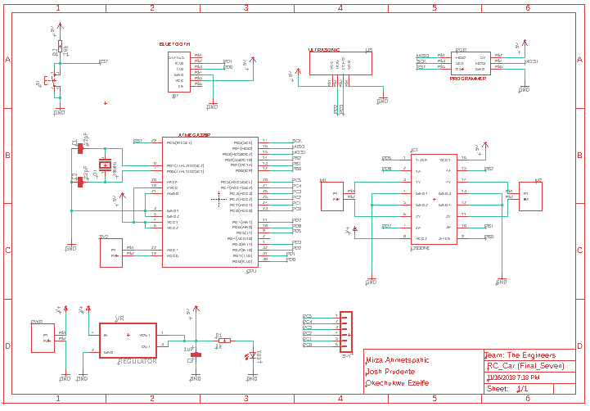
Final
Schematic

Slide 6
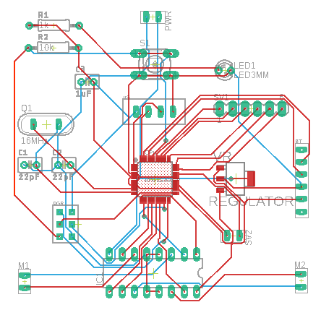
Final Board
Layout

Slide 7
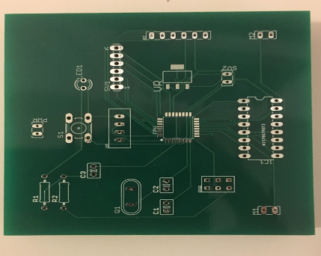
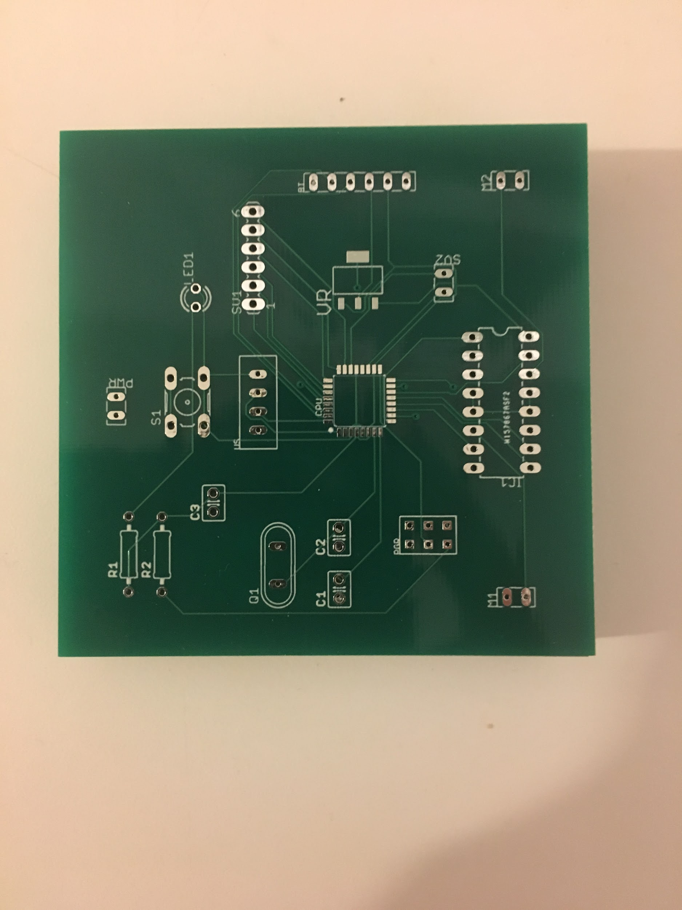
Final Board
Layout

Slide 8
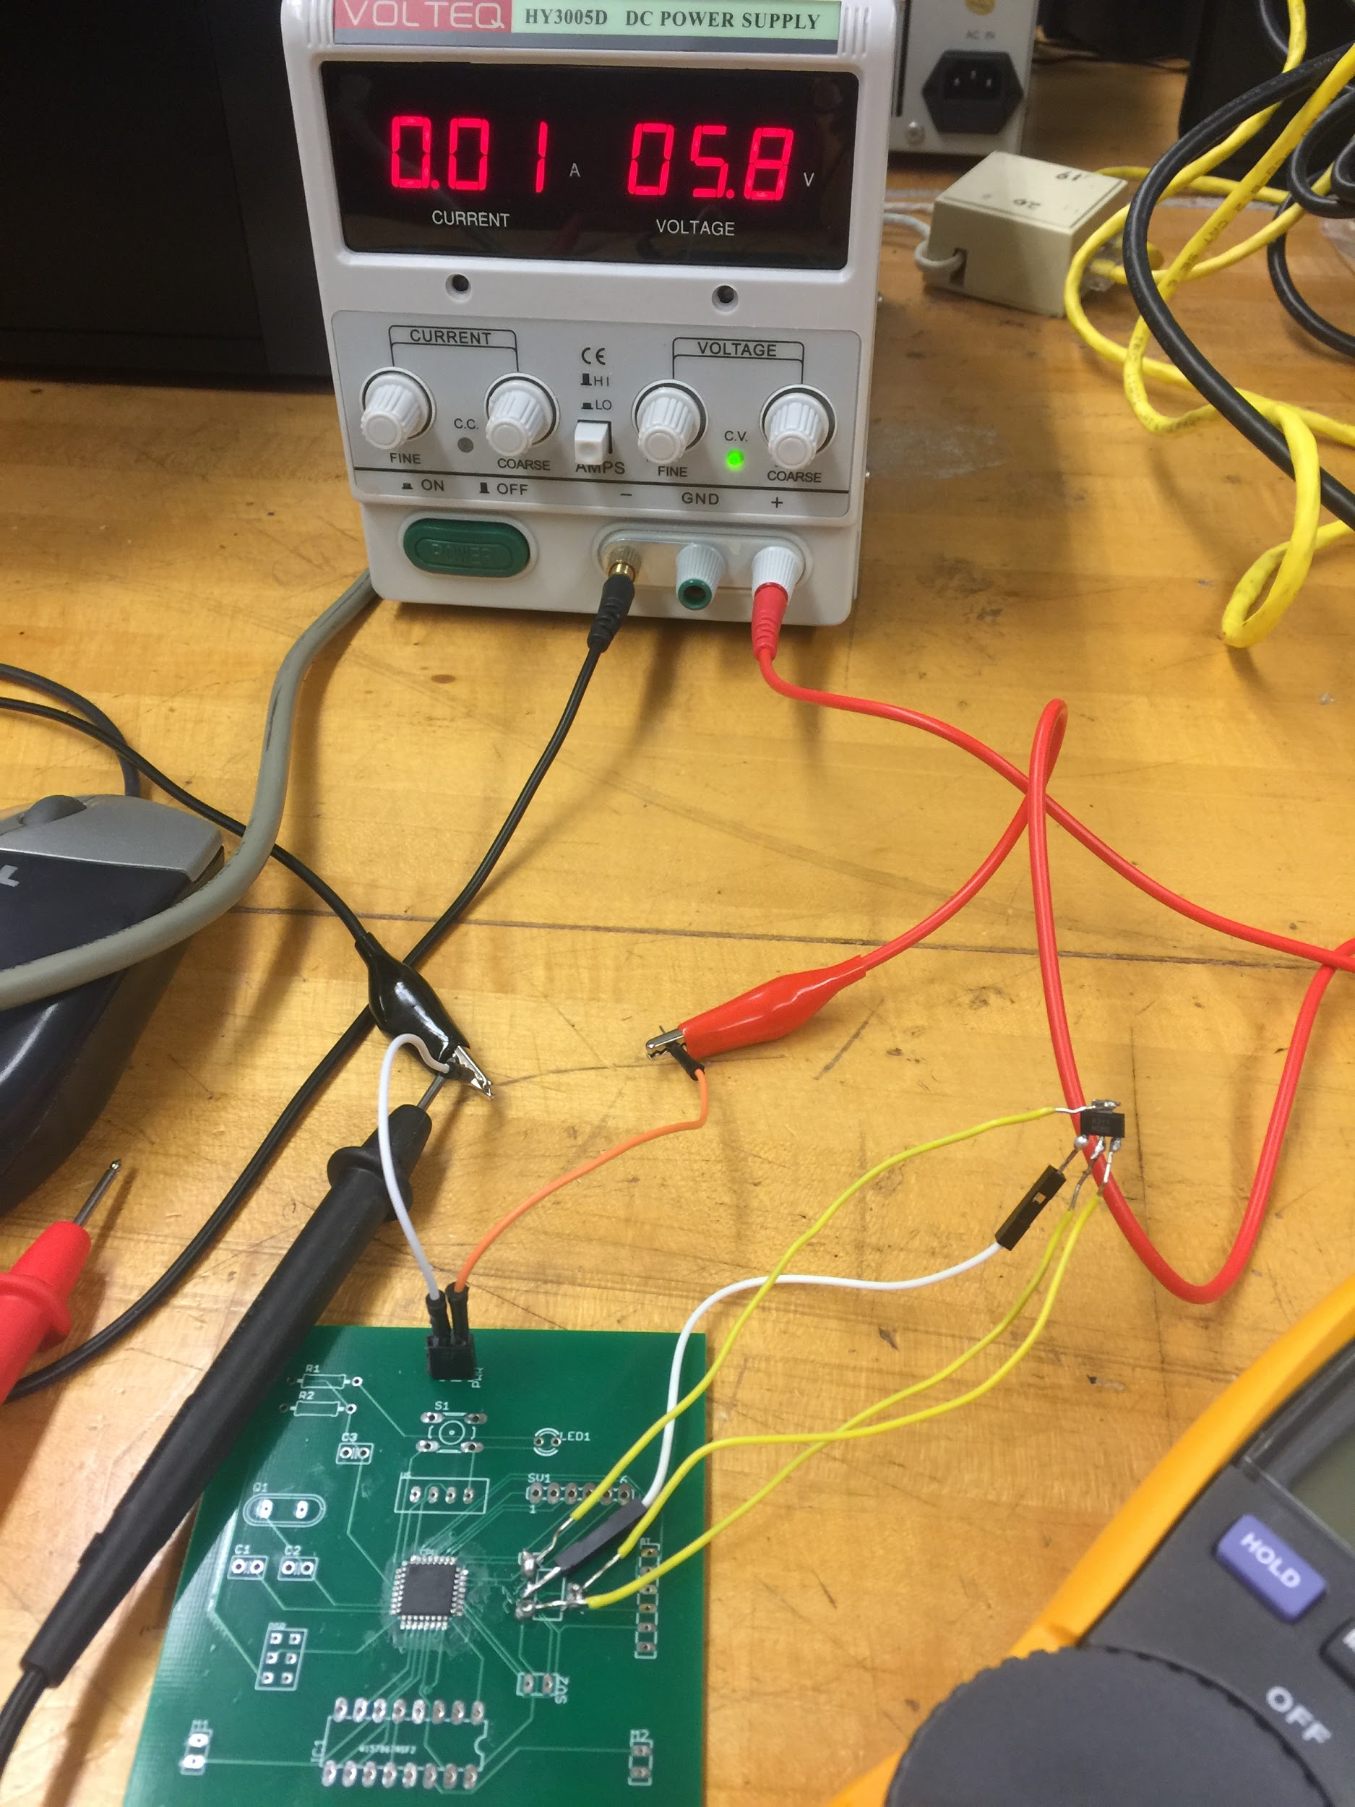
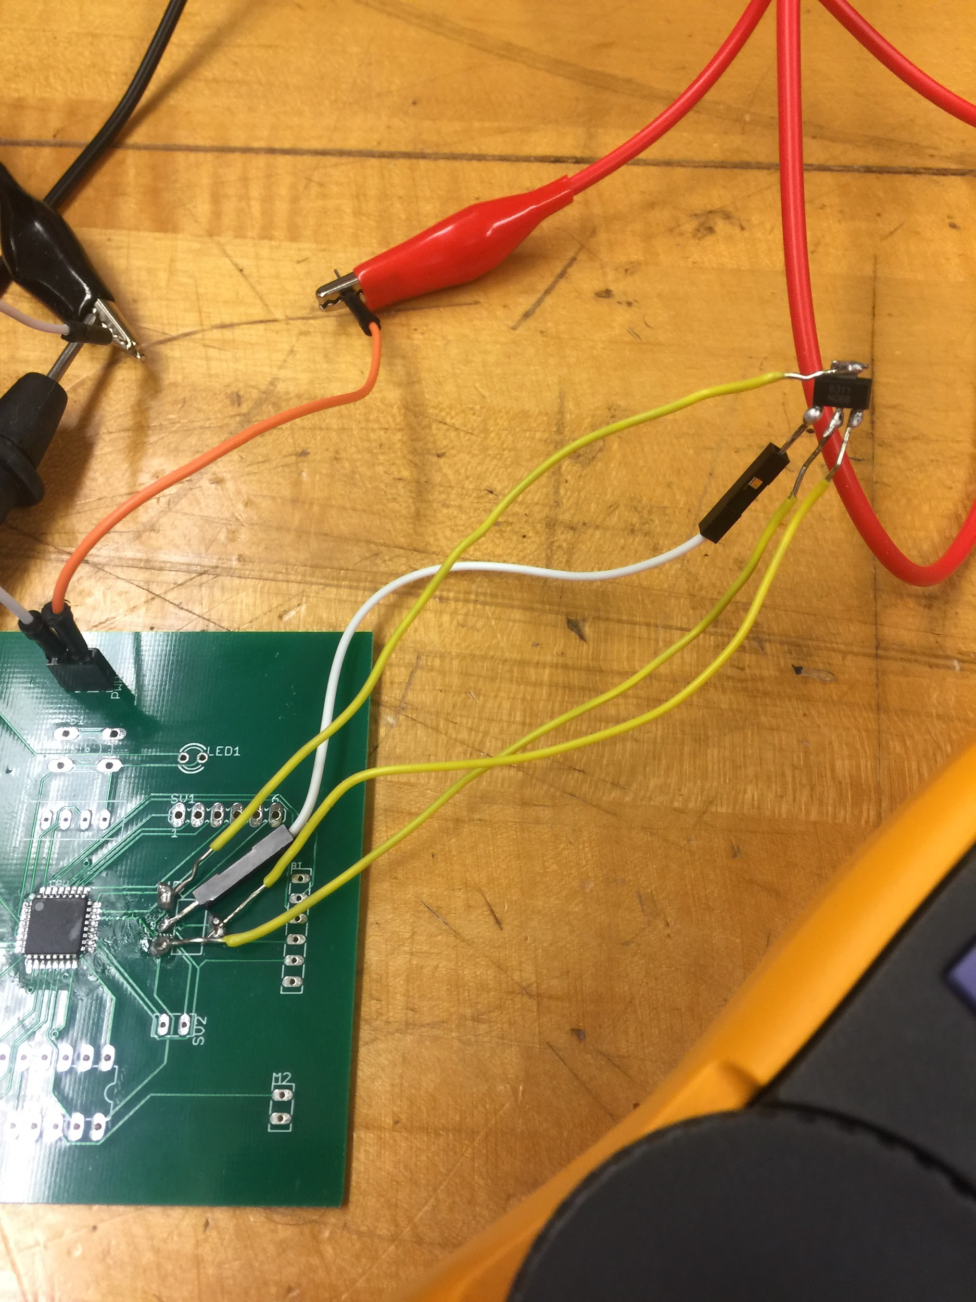

Slide 9

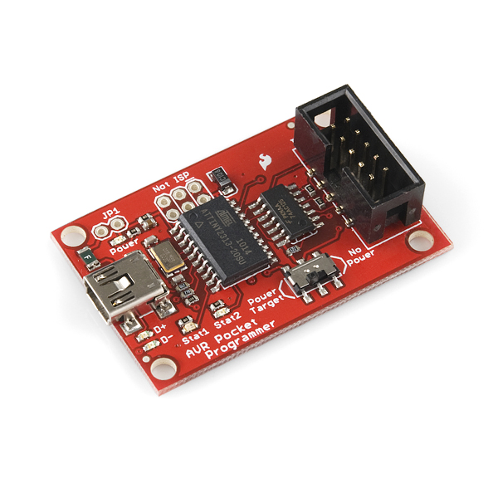
Pocket AVR Programmer
Communicates between ISP and AVR
Uploads the bootloader via Arduino IDE
Programmed through Atmel Studio 7.0
Written in C
Needs the help of AVRDUDE

Slide 10
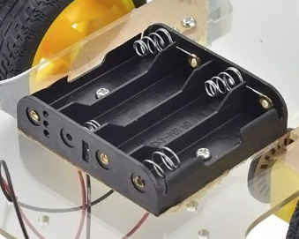
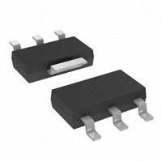
Power Supply and Voltage Regulator
Power Supply
Battery box
4 AA Batteries
6V output
Voltage Regulator
5V output

Slide 11
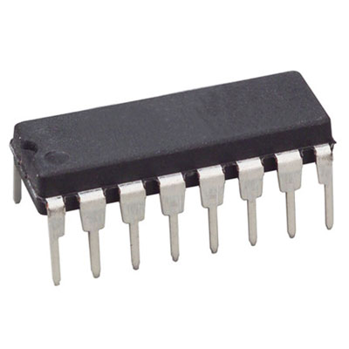
Motor Driver
L293D Motor Driver
Controls both motor direction and speed
Utilizes 2 PWM Channels
Controls 2 DC Motors
Requires 2 Vcc inputs
Vcc2 gets 4.5 - 36V
Vcc1 gets 5V
Operated through an H-Bridge

Slide 12
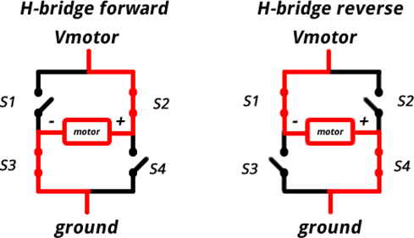
H-Bridge
Switches the polarity of a voltage applied to a load.
Allows voltage to travel in both directions across a board.
Works with the driver to make the motor run
Uses Pwm signals

Slide 13
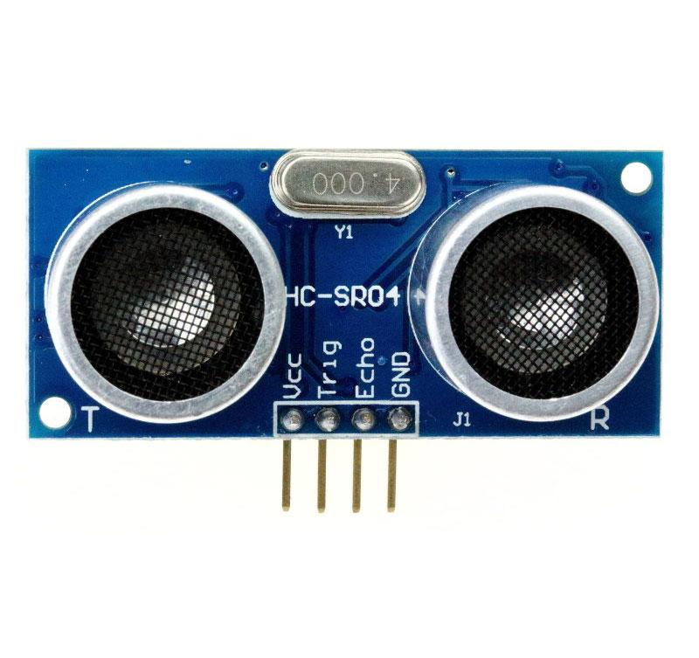
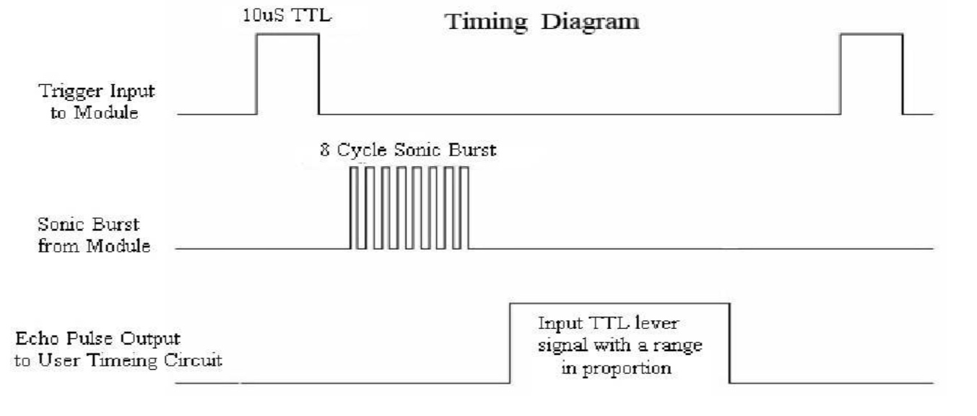
Ultrasonic Distance Sensor
Measures distance, used to avoid obstacles
How does it work?
Pulse with a duration of 10us is sent to trigger pin
Sends ultrasonic pulses
If obstacle is detected, echo pin goes from high to low
Measures width of the pulse

Slide 14
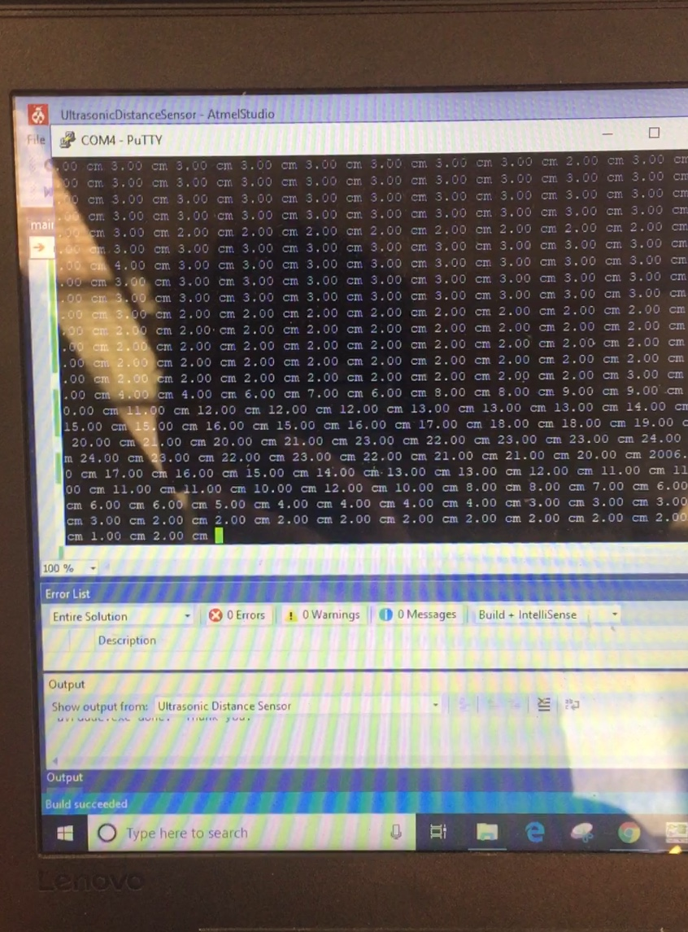
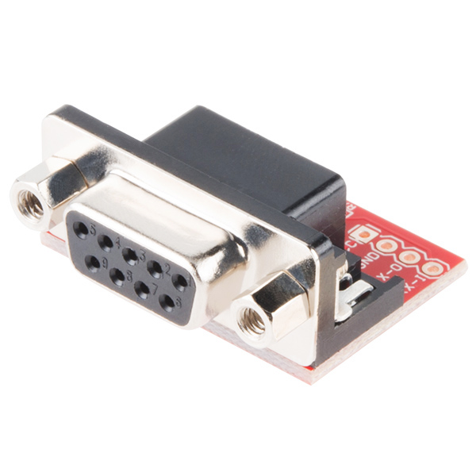
RS232 Shifter
Serial Port to USB adapter
Used for testing the ultrasonic distance sensor
Used Putty to display
Utilizes RXD and TXD pins

Slide 15
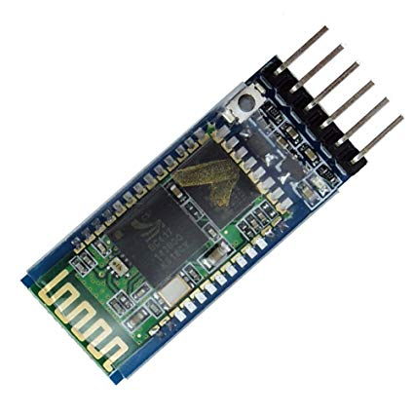
Bluetooth Module
Bluetooth HC-05 Module
Designed for transparent wireless serial connection setup.
Used to receive instruction from Android app
Transmits instructions to other subsystems

Slide 16

Android Studios
Custom GUI application
Communicates between Android device and PCB
Sends instructions to the PCB

Slide 17
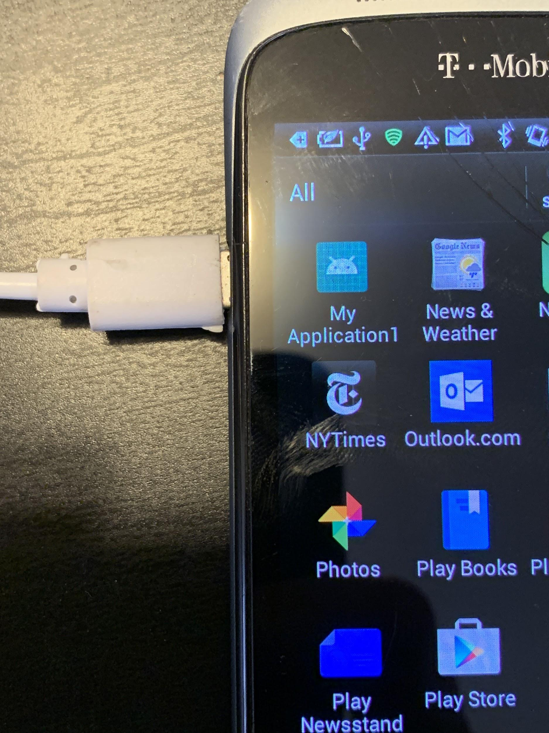
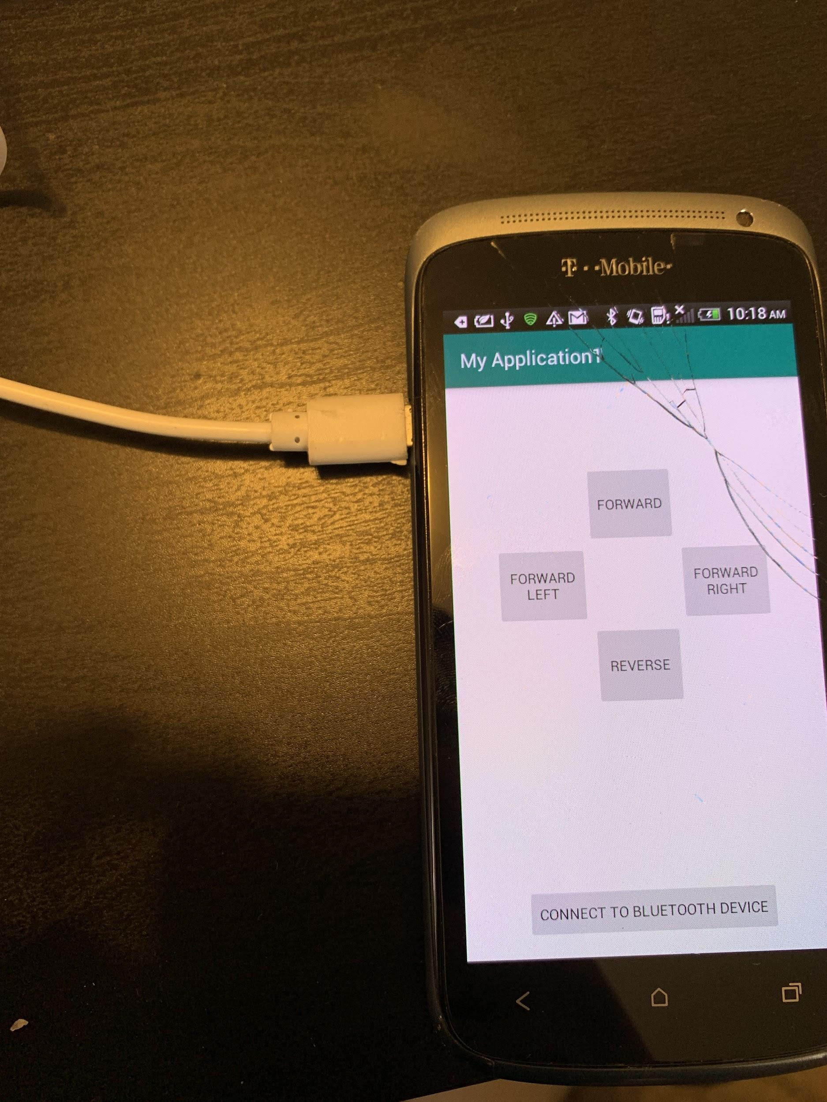
Android Studios GUI

Slide 18
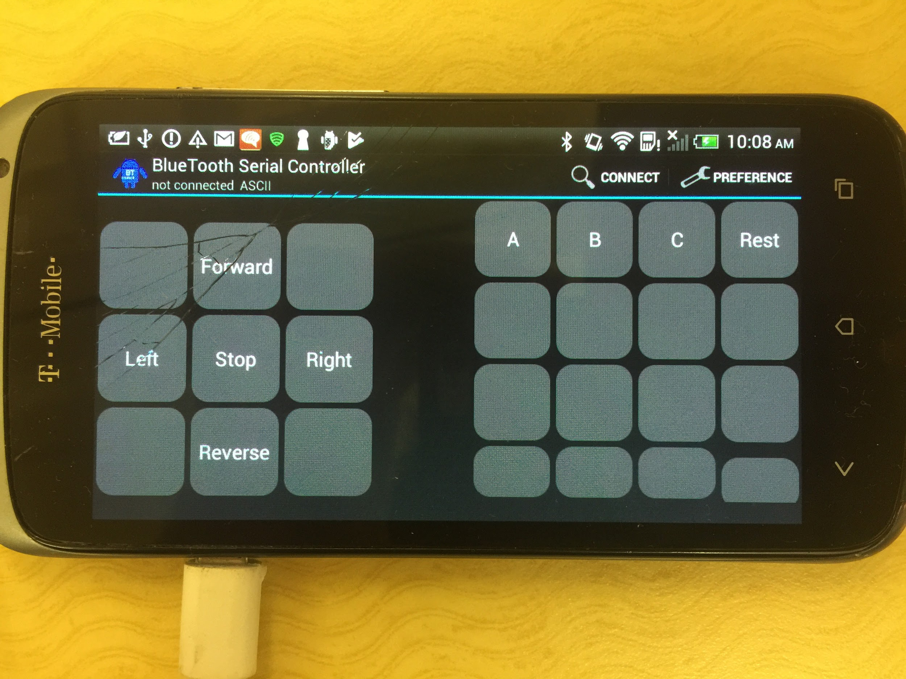

Slide 19
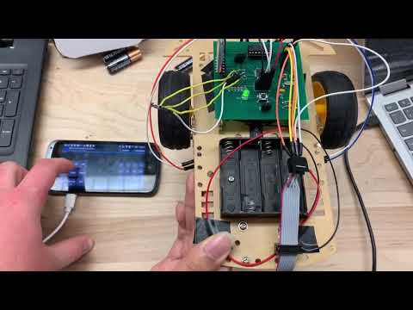
Control Mode
https://youtu.be/5bEnLw6w6ZE

Slide 20
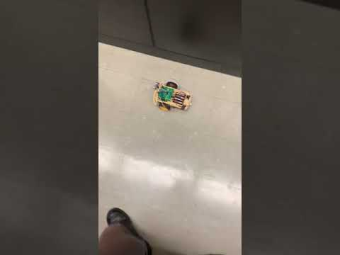
Self-Driving Mode
https://youtu.be/m8Vk_cbCcO8

Slide 21
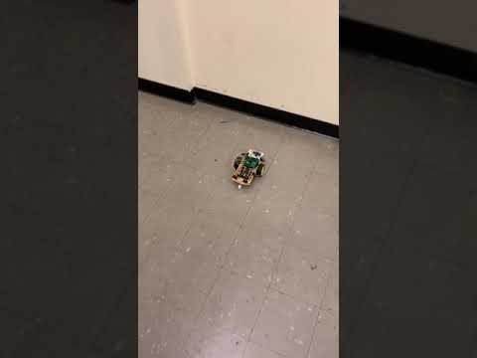
Hybrid Mode

Slide 22
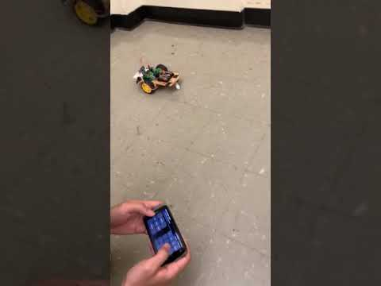
Full Integration

Slide 23
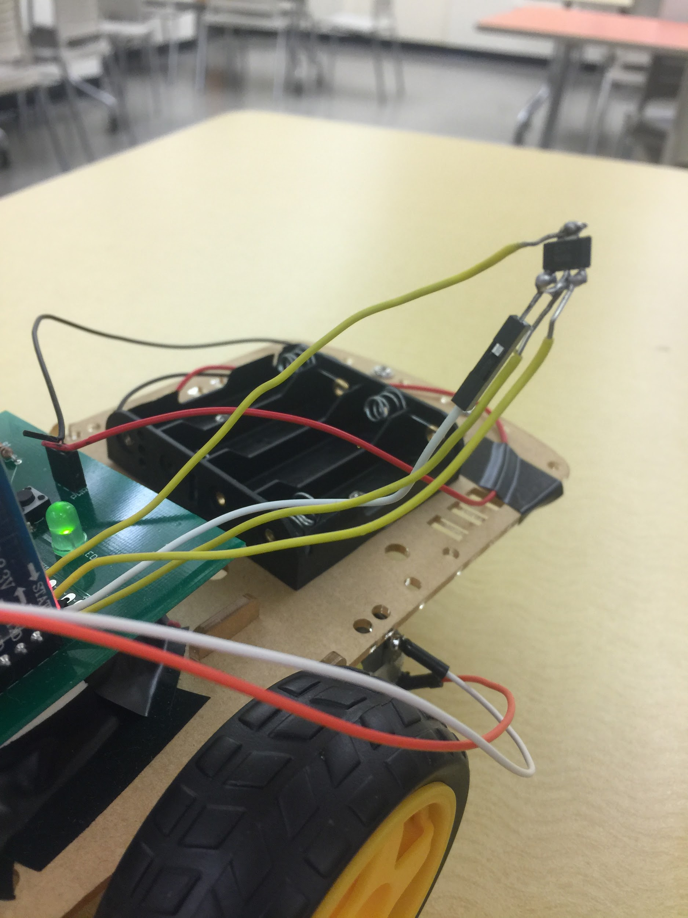
Errors: The Voltage Regulator
The pads of the voltage regulator were incorrectly placed
Solution: Use jumper wires to connect to the correct pins
Consequences:
Increased the possibility of the board breaking if the Voltage Regulator broke
Had to be handled with the utmost care
Jumper wires prevented us from soldering on pin headers for PORTC pins 1-6
Demotivated the team
Required the use of a “booster seat” when mounted onto the PCB board

Slide 24
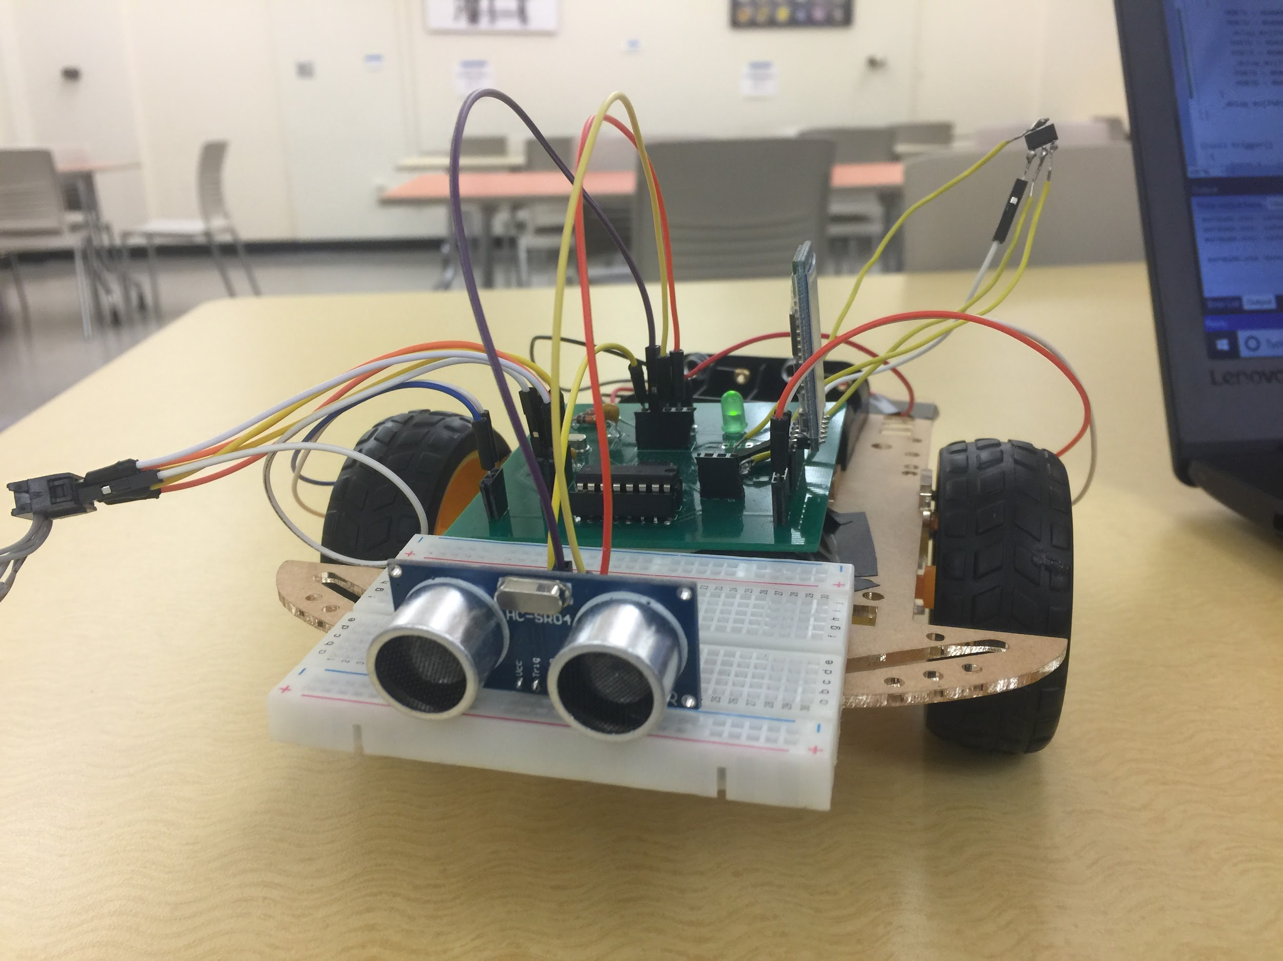
Errors: Poor Positioning
The Ultrasonic Distance Sensor was placed in the center of the board
Jumper wires got in the way of the sensor
Solution: Move the sensor into the very front of the Chassis Car
Consequence: Risks the possibility of the sensor being damaged if a collision would occur

Slide 25
Errors: Android Studios
Unable to establish connection between custom GUI and bluetooth module
Application would crash when any button that was an instruction was pressed
A five year old HTC one s phone was used

Slide 26
What we learned Mirza
Do not underestimate the complexity of a fairly “straightforward” project
Double and triple check your wiring
Read the data sheets and manuals thoroughly
Per Professor Tandon “Under promise over deliver”

Slide 27
What we Learned - Okechukwu
Always have a backup plan when things go wrong
Always be aware of due dates not how far away they seem
Always talk to team members about issues regarding the projects
Never be afraid to ask for help from teammates or the professor

Slide 28
What we Learned - Josh
Before Senior Design
I used to connect power to ground.
After Senior Design
I no longer connect power to ground.

Slide 29

Questions ?

